Slide 1
Soccer Database Project
Team member: Chi Zhang Zhiwei Zhang Bingling Fu

Slide 2
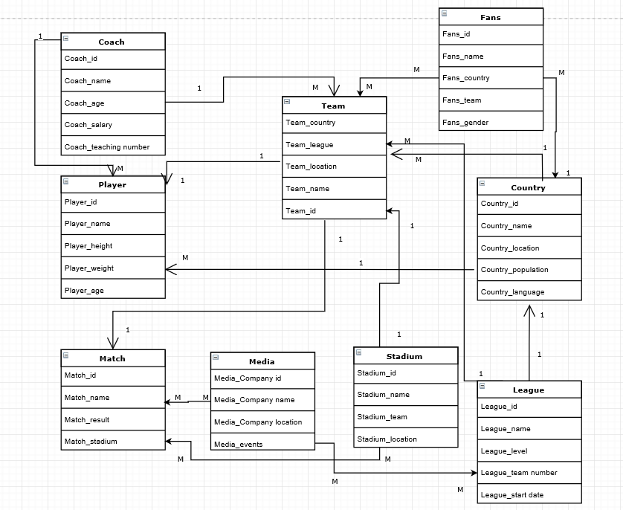
ER diagram

Slide 3
Content
1. project statement
2. data
3. preprocessing
4. social media code
5.next step

Slide 4
project statement
Our database project is about soccer. In this domain, there are nine entities. These entities are player, team, league, country, match, media, stadium, fans and coach. We use an Entity Relationship Diagram to model the database. Each Entity in our project has a unique identifier as primary key and relationships between them have one-one, many-one, and many-many. We gather our data from Social Media like Twitter, Instagram, Facebook, etc. Techniques we use are Mysql, Tagging, Python, etc.
All in all, this project is to find the influence of soccer to the public. A soccer player can find out his popularity and a scout might find who is a potential superstar. This database may be used for several different types of roles.

Slide 5
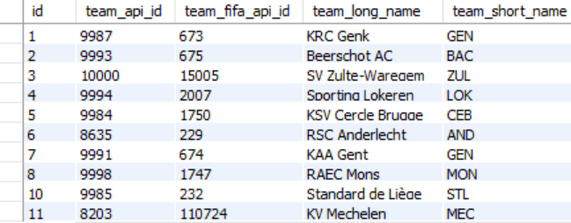
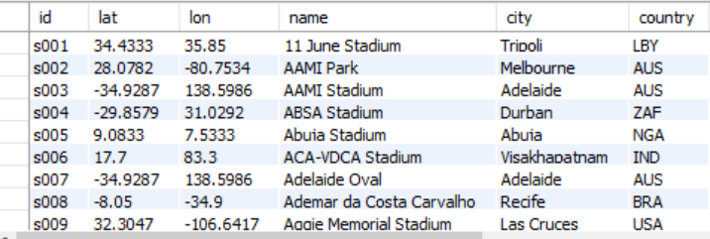
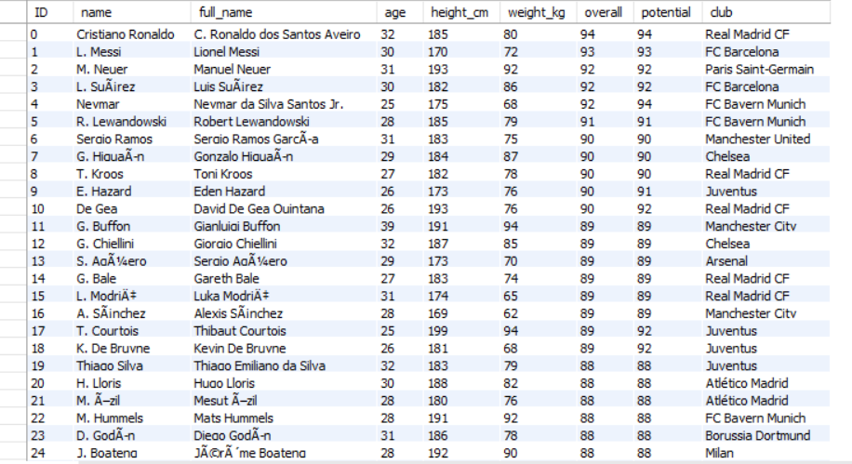
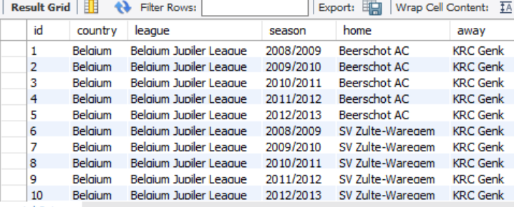
data

Slide 6
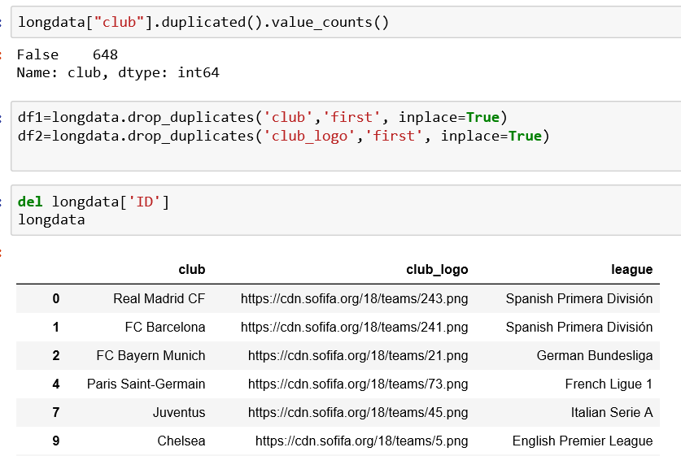
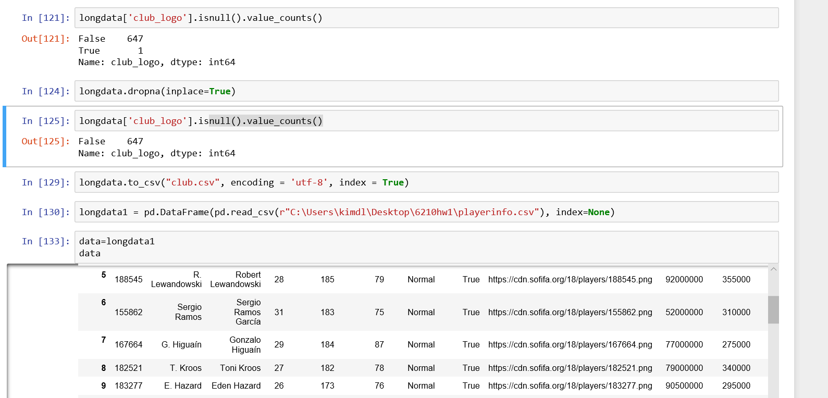
Auditng/ preprocessing

Slide 7
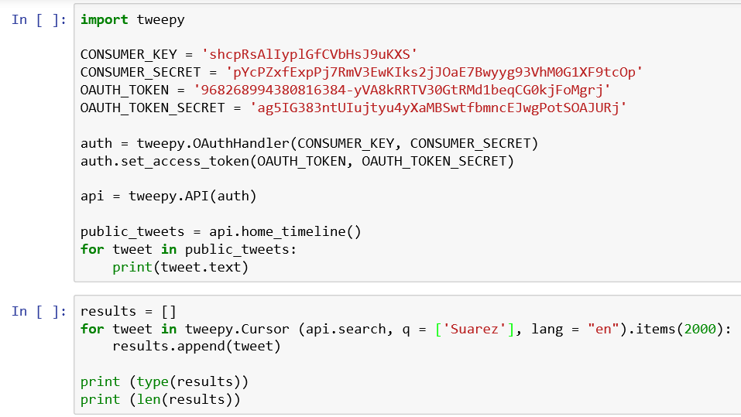
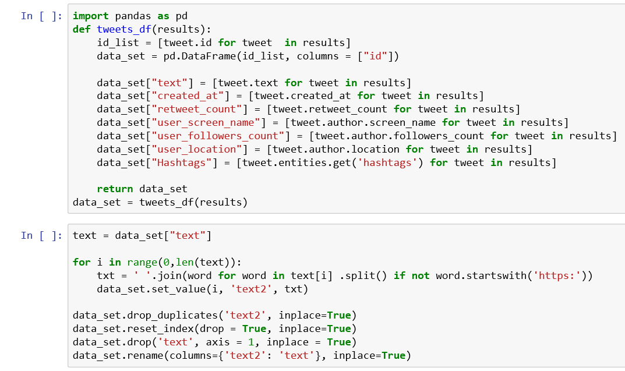
social media code

Slide 8
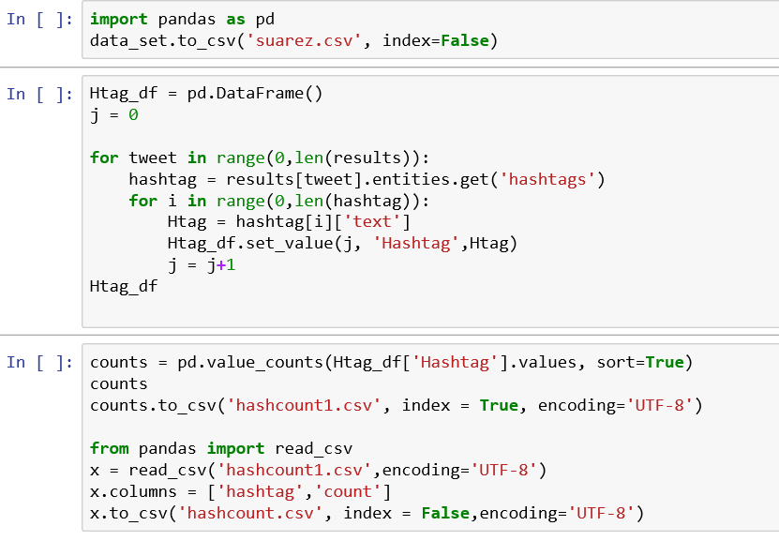
social media code

Slide 9
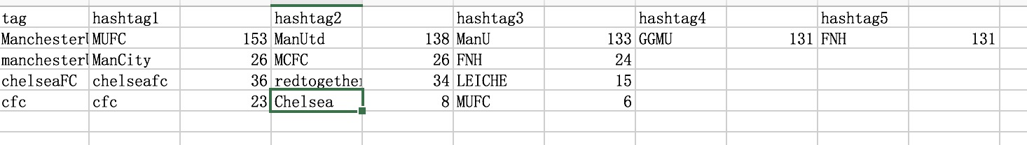
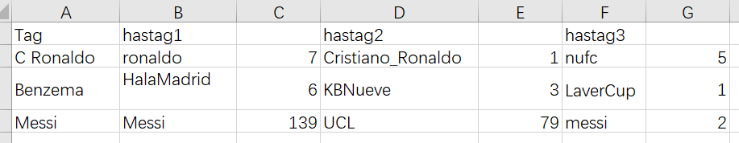
Tag example

Slide 10
What are people saying about me (somebody)?
Dislikes and likes. Retweets.
ii. How viral are my posts?
Retweets.
iii. How much influence to my posts have?
Retweets. Is it retweeted by player or team.
iv. What posts are like mine?
Search tweets by same tags.
v. What users post like me?
Users using alike tags frequently.
vi. Who should I be following?
Those who use similar tags and have a quantity of tweets rapidly
vii. What topics are trending in my domain?
This is divided into different leagues and different cups
viii. What keywords/ hashtags should I add to my post?
Those scrapped straight from the name and those people frequently use on twitter.
ix. Should I follow somebody back?
This one is very like the question who should I be following.
x. What is the best time to post?
xi. Should I add a picture or url to my post?
xiii. What’s my reach?

Slide 11
next step
1. Figure out the difference between @ & # since we find people tend to use @team rather than #team
2. Scrap twitters by the order of time to search for popularity
3. Examine the tag we created is whether a proper one to use
4. Try to include emojis to define alike users

Slide 12
Thank you

